Slide 1
Hw2(a), pre pruning, post pruning
2022/09/04
양동현, 양준영, 문상원

Slide 2
Ⅰ. | Homework p2(a)
Ⅱ. | Pre pruning
Ⅲ. | Post pruning

Slide 3

Calculate entropy
Cart algorithm(gini index)
Id3 algorithm(entrophy)
def entropy(target_col):
elements, counts = np.unique(target_col, return_counts = True)
entropy = -np.sum([(counts[i]/np.sum(counts))*np.log2(counts[i]/np.sum(counts)) for i in range(len(elements))])
return entropy

Slide 4

Calculate entropy-weighted entropy
def InfoGain(data,split_attribute_name,target_name):
total_entropy = entropy(data[target_name])
vals,counts=np.unique(data[split_attribute_name],return_counts=True)
Weighted_Entropy = np.sum([(counts[i]/np.sum(counts))*
entropy(data.where(data[split_attribute_name]==vals[i]).dropna()[target_name])
for i in range(len(vals))])
Information_Gain = total_entropy - Weighted_Entropy
return Information_Gain
분활 후 엔트로피

Slide 5
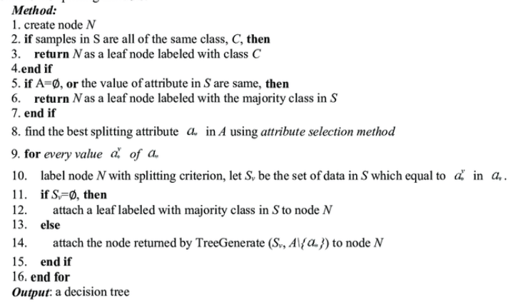
def TreeGenerate(data,originaldata,features,target_attribute_name,parent_node_class = None):
if len(np.unique(data[target_attribute_name])) <= 1:
return np.unique(data[target_attribute_name])[0]
elif len(data)==0:
return np.unique(originaldata[target_attribute_name])\
[np.argmax(np.unique(originaldata[target_attribute_name], return_counts=True)[1])]
elif len(features) ==0:
return parent_node_class
else:
parent_node_class = np.unique(data[target_attribute_name])\
[np.argmax(np.unique(data[target_attribute_name], return_counts=True)[1])]
item_values = [InfoGain(data,feature,target_attribute_name) for feature in features]
best_feature_index = np.argmax(item_values)
best_feature = features[best_feature_index]
tree = {best_feature:{}}
features = [i for i in features if i != best_feature]
for value in np.unique(data[best_feature]):
sub_data = data.where(data[best_feature] == value).dropna()
subtree = TreeGenerate(sub_data,data,features,target_attribute_name,parent_node_class)
tree[best_feature][value] = subtree
return(tree)
InfoGain 함수를 이용해서 best splitting attribute를 구함

Slide 6
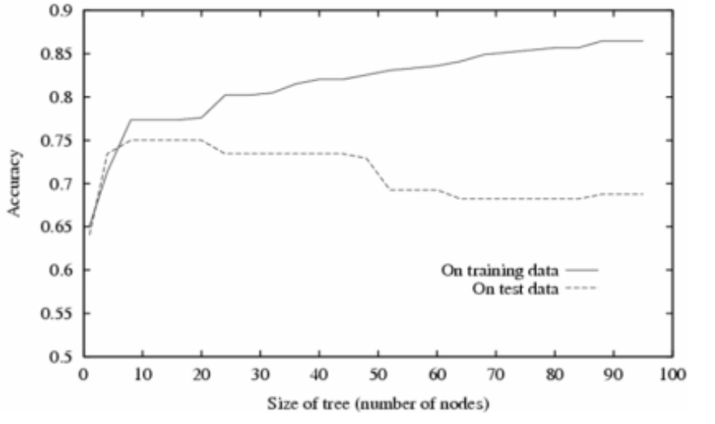
overfitting(good result at training data but bad result at test data)
Tree increase
Test data accuracy decrease
Training data accuracy increase

Slide 7
How to reduce overfitting?
Reduce tree: Pruning(use to avoid overfitting in decision tree)
Training data error increase
Test data error decrease
Pre-pruning: early stopping
Adjusting hyperparameter(reduce branches)
-chi square pruning, svm pre pruning, minimum number of object pruning
Post-pruning: pruning afther learning
-reduced error pruning, minimum error pruning, cost-complexity pruning

Slide 8
Post pruning
Post pruning is usually succesful
(because it is not easy to estimate when to stop growing tree)
Concept: make tree and use test data to check error
Prune the branch when error increase
Build the tree by using the training set, then apply a statistical test to estimate whether pruning or expanding a particular node is likely to produce an improvement beyond the training set.
Error estimation
Significance testing (e.g., Chi-square test)

Slide 9
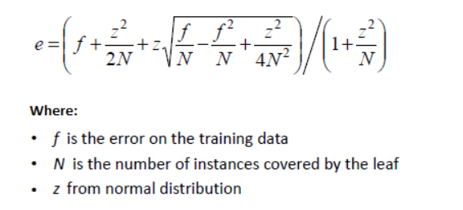
Post pruning
Error estimate
If the error rate increase after splitting -> prune

Slide 10
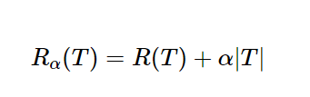

Cost complexity pruning
A: complexity parameter
T: number of terminal nodes in T
R(T): total misclassification rate
A|T| penalty part
Minimize -> small size
r(t): probability of making wrong classification
For poin in node t

Slide 11
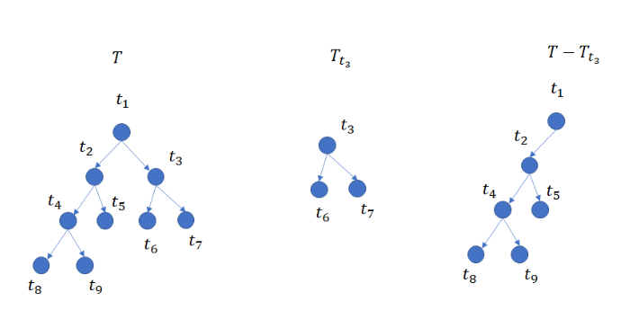

Slide 12
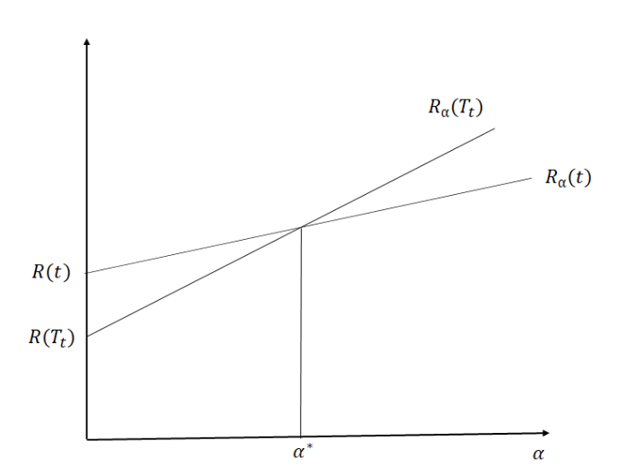
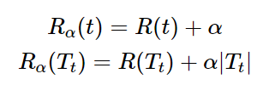
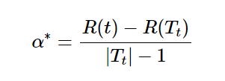
Smallest a^* node: weakest link

